Slide 1
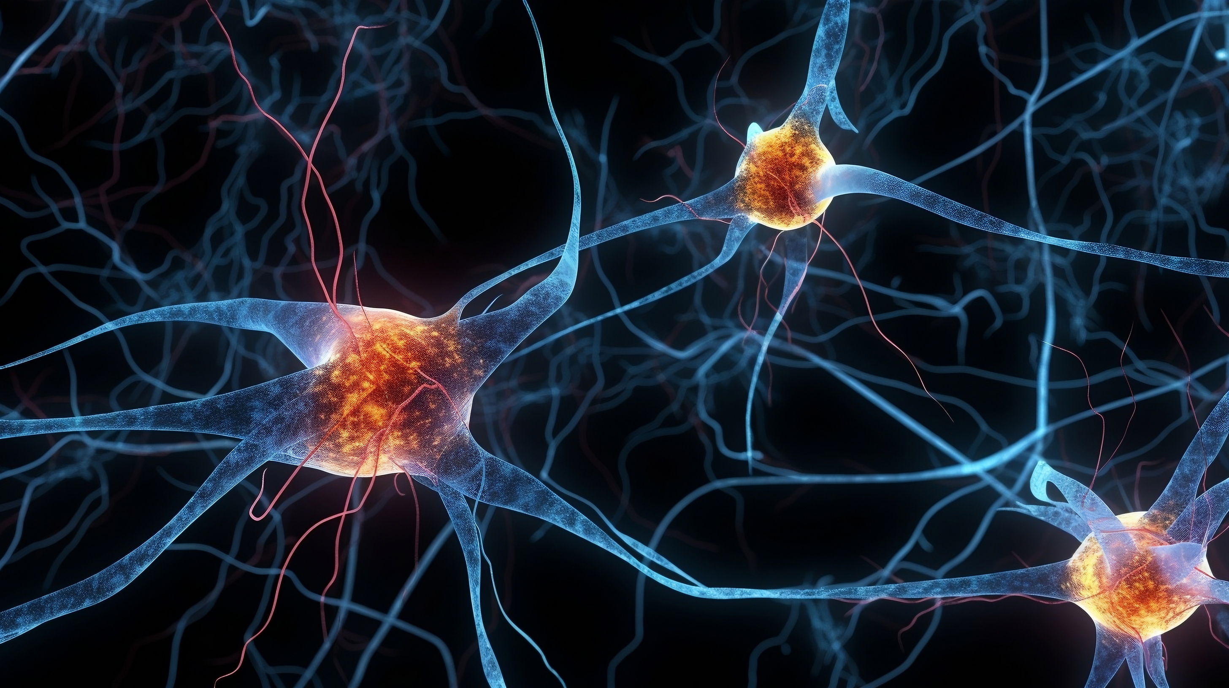

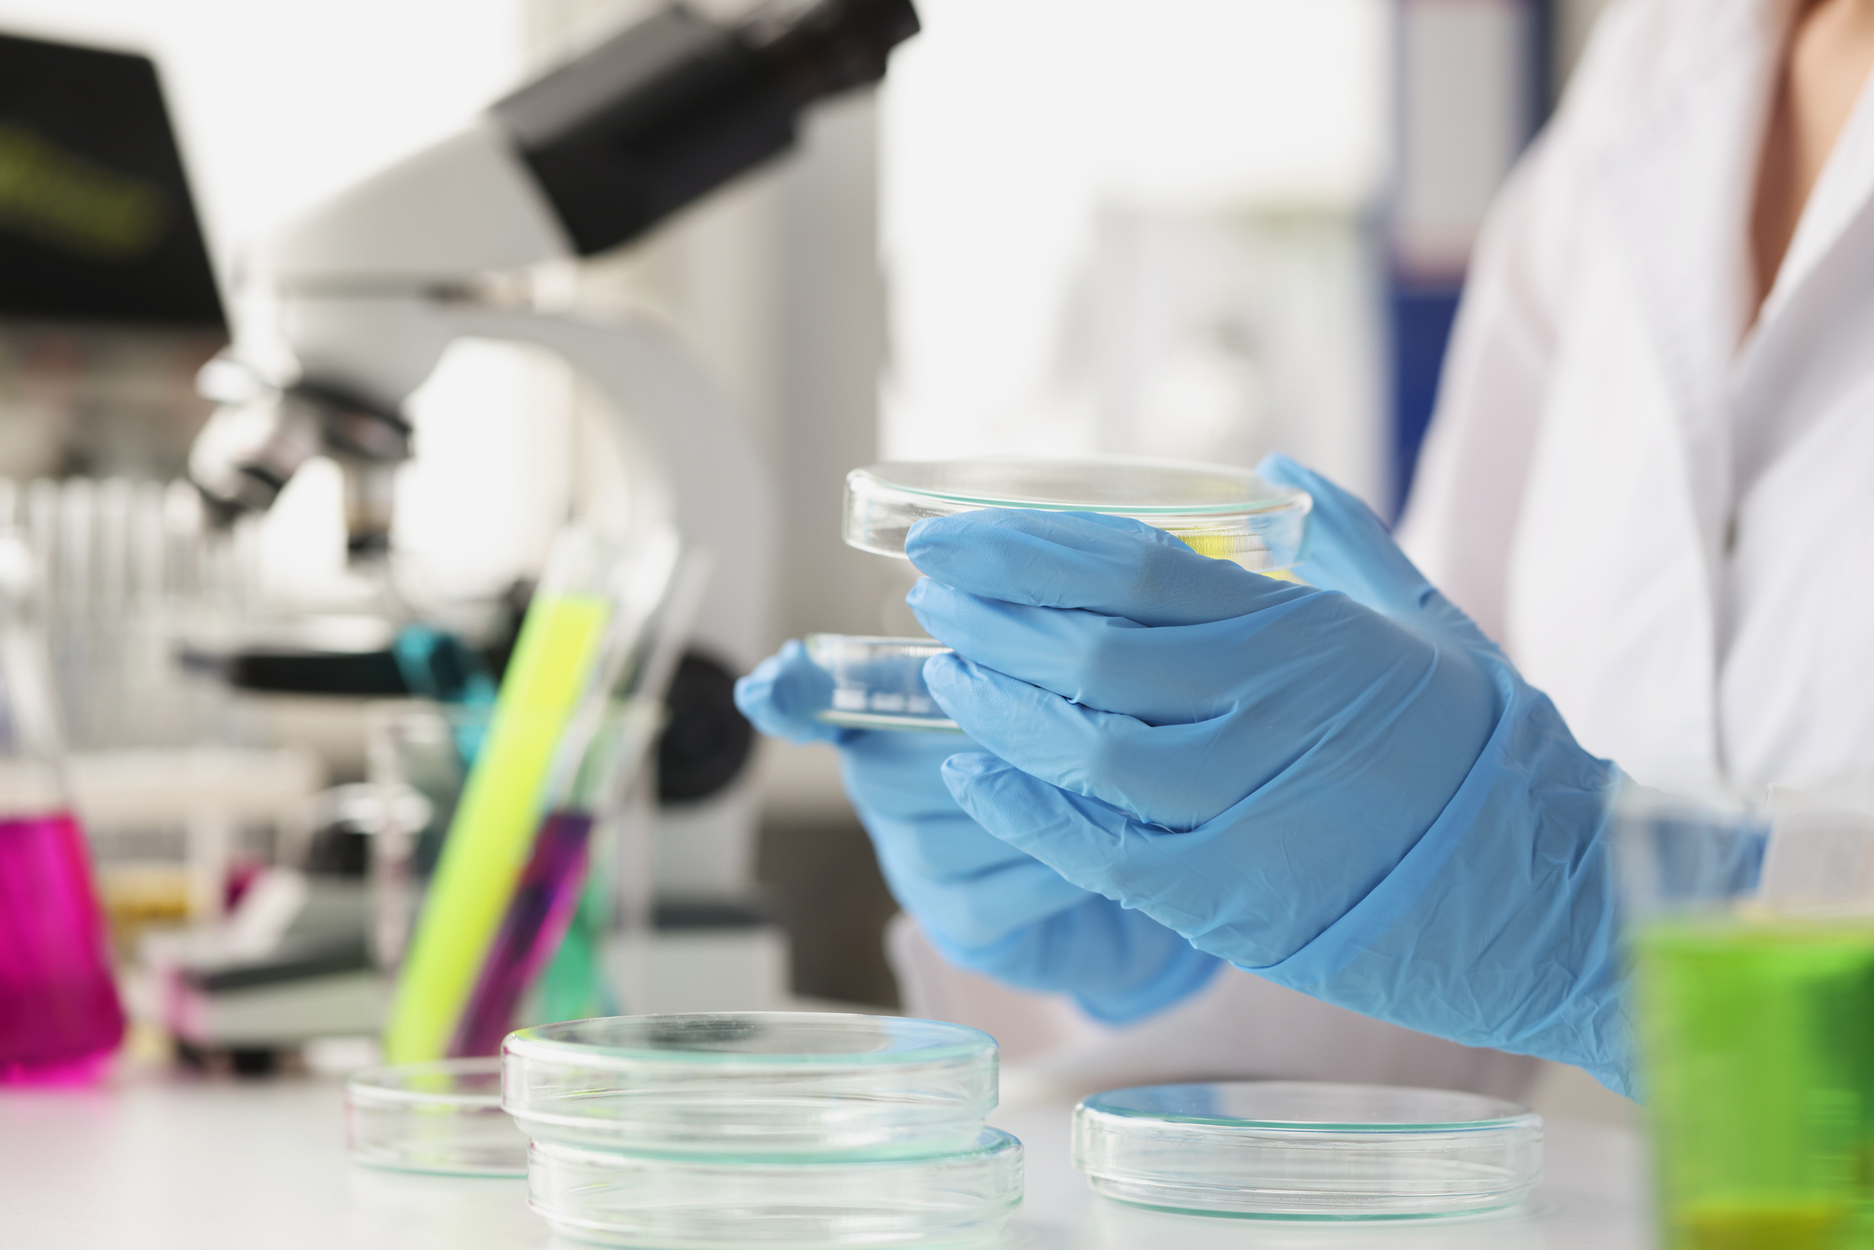


BASICS OF HUMAN BIOLOGY - CELLS

Slide 2
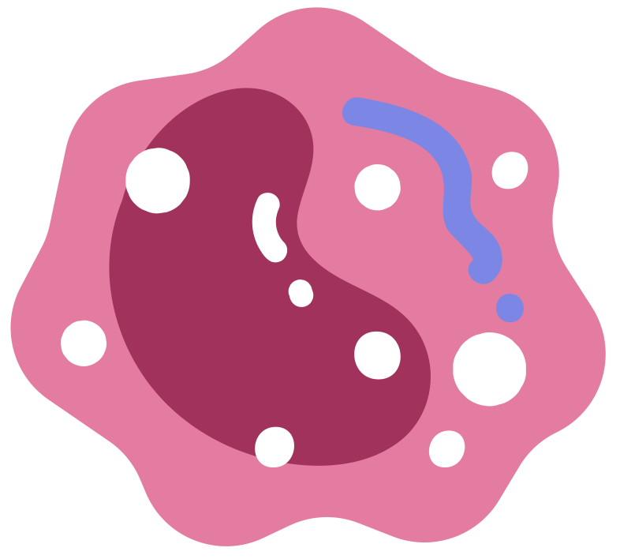
CELLS
Notes:
So lets get into cells, tissues and organs

Slide 3
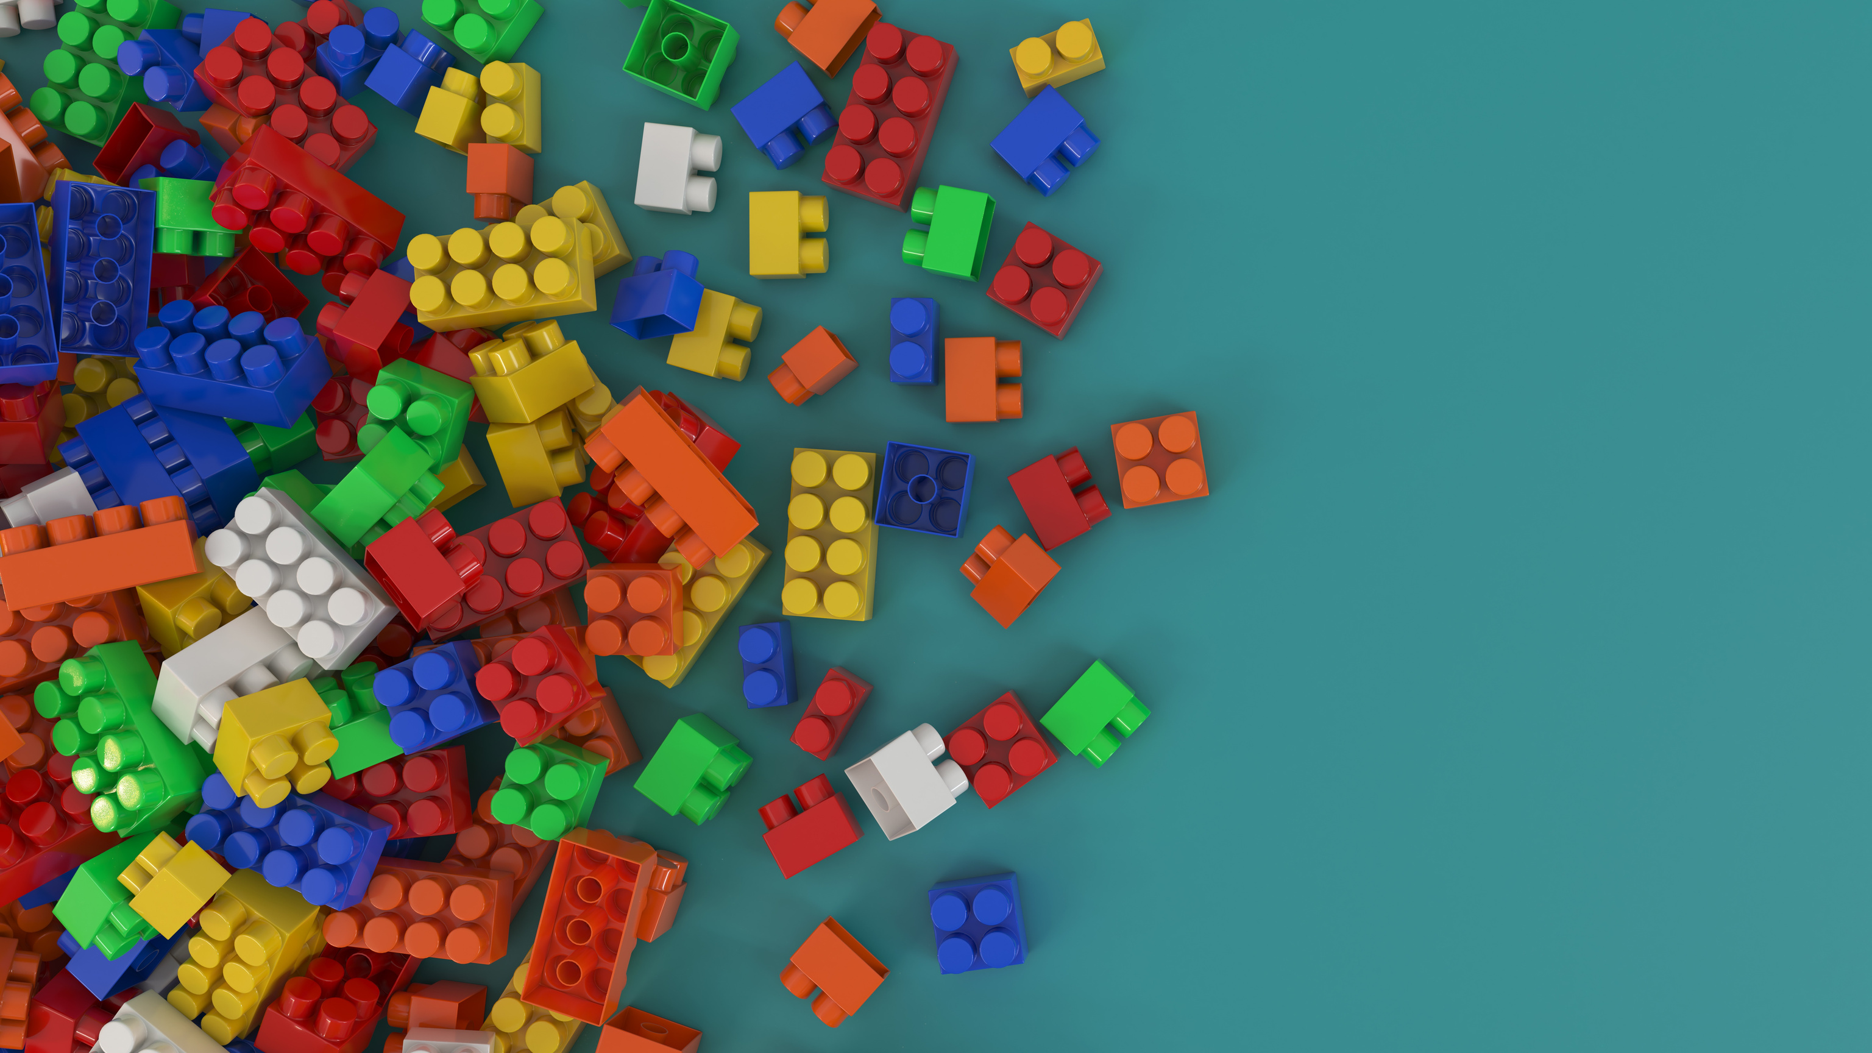
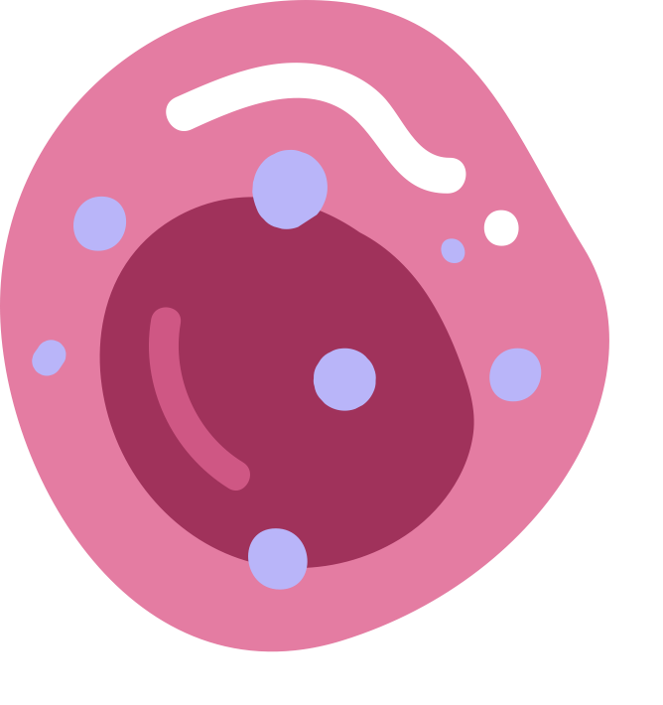
WHAT ARE CELLS?
Cells are the smallest biological unit and make up all living organisms.

Slide 4
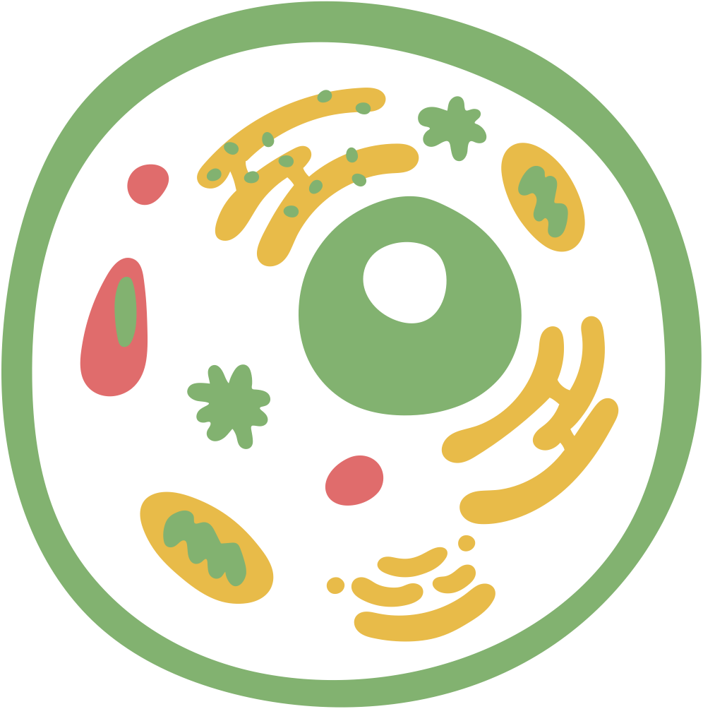

Cell Organelles
“Powerhouse”
MITOCHONDRIA
“Control Centre”
NUCLEUS
CELL MEMBRANE
“Gatekeeper”
Notes:
The mitochondria generate the energy necessary for cells to function, playing a key role in metabolism and drug metabolism.
The nucleus contains the cell’s genetic material (DNA) and is responsible for regulating gene expression and cell division.
The cell membrane controls what enters and exits the cell, playing a critical role in drug absorption, distribution, and cell signaling.

Slide 5

What do cells need to grow?
Cells need:
• Nutrients (like food)
• Oxygen
• Controlled temperature (~37°C)
• Moisture/liquid environment
• Protection from infection

Slide 6
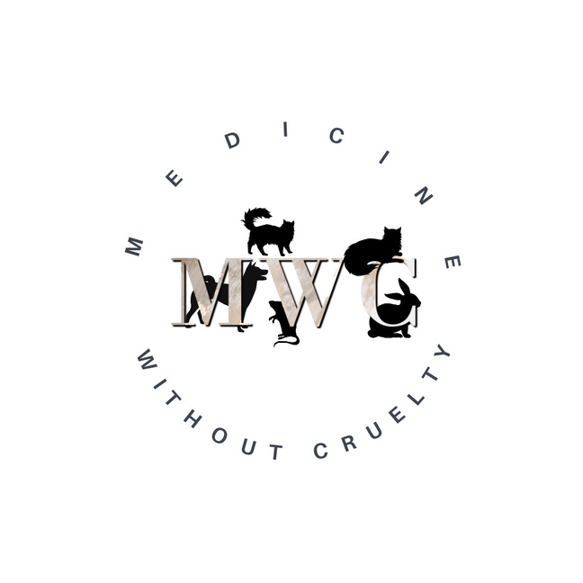
TISSUES AND ORGANS

Slide 7
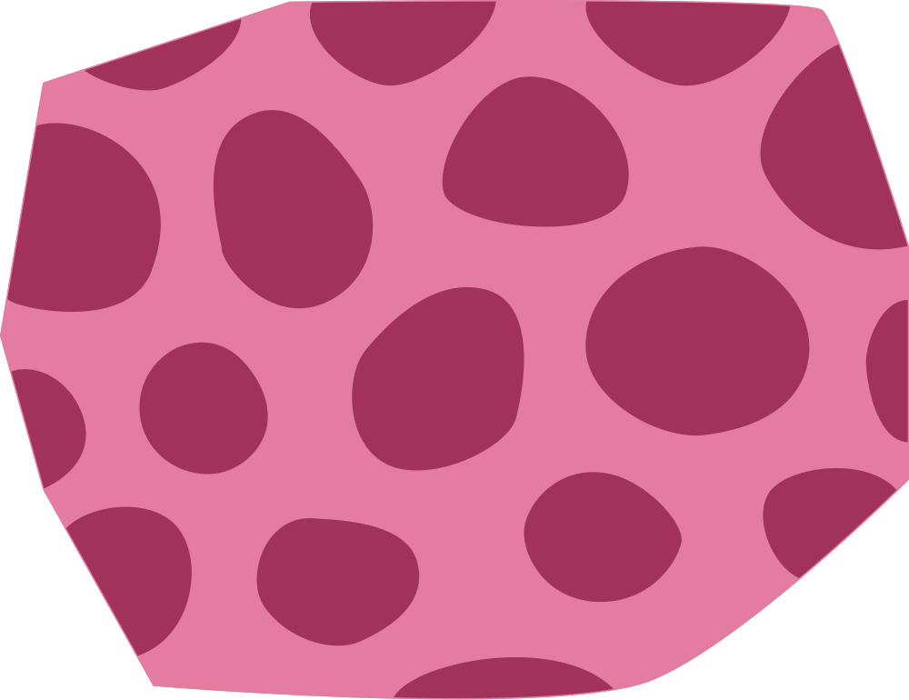
HUMANS ARE MADE UP OF CELLS, TISSUES AND ORGANS.
Notes:
Yes, all animals have cells, tissues, and organs, but the complexity of these structures can vary significantly across different species.
Animals don’t replicate human biology, and that’s a big problem!

Slide 8
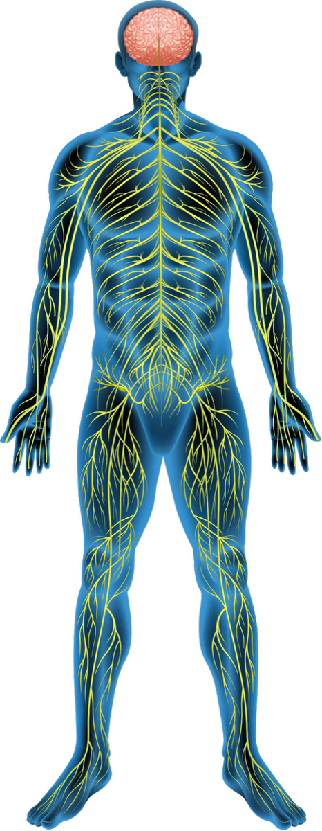
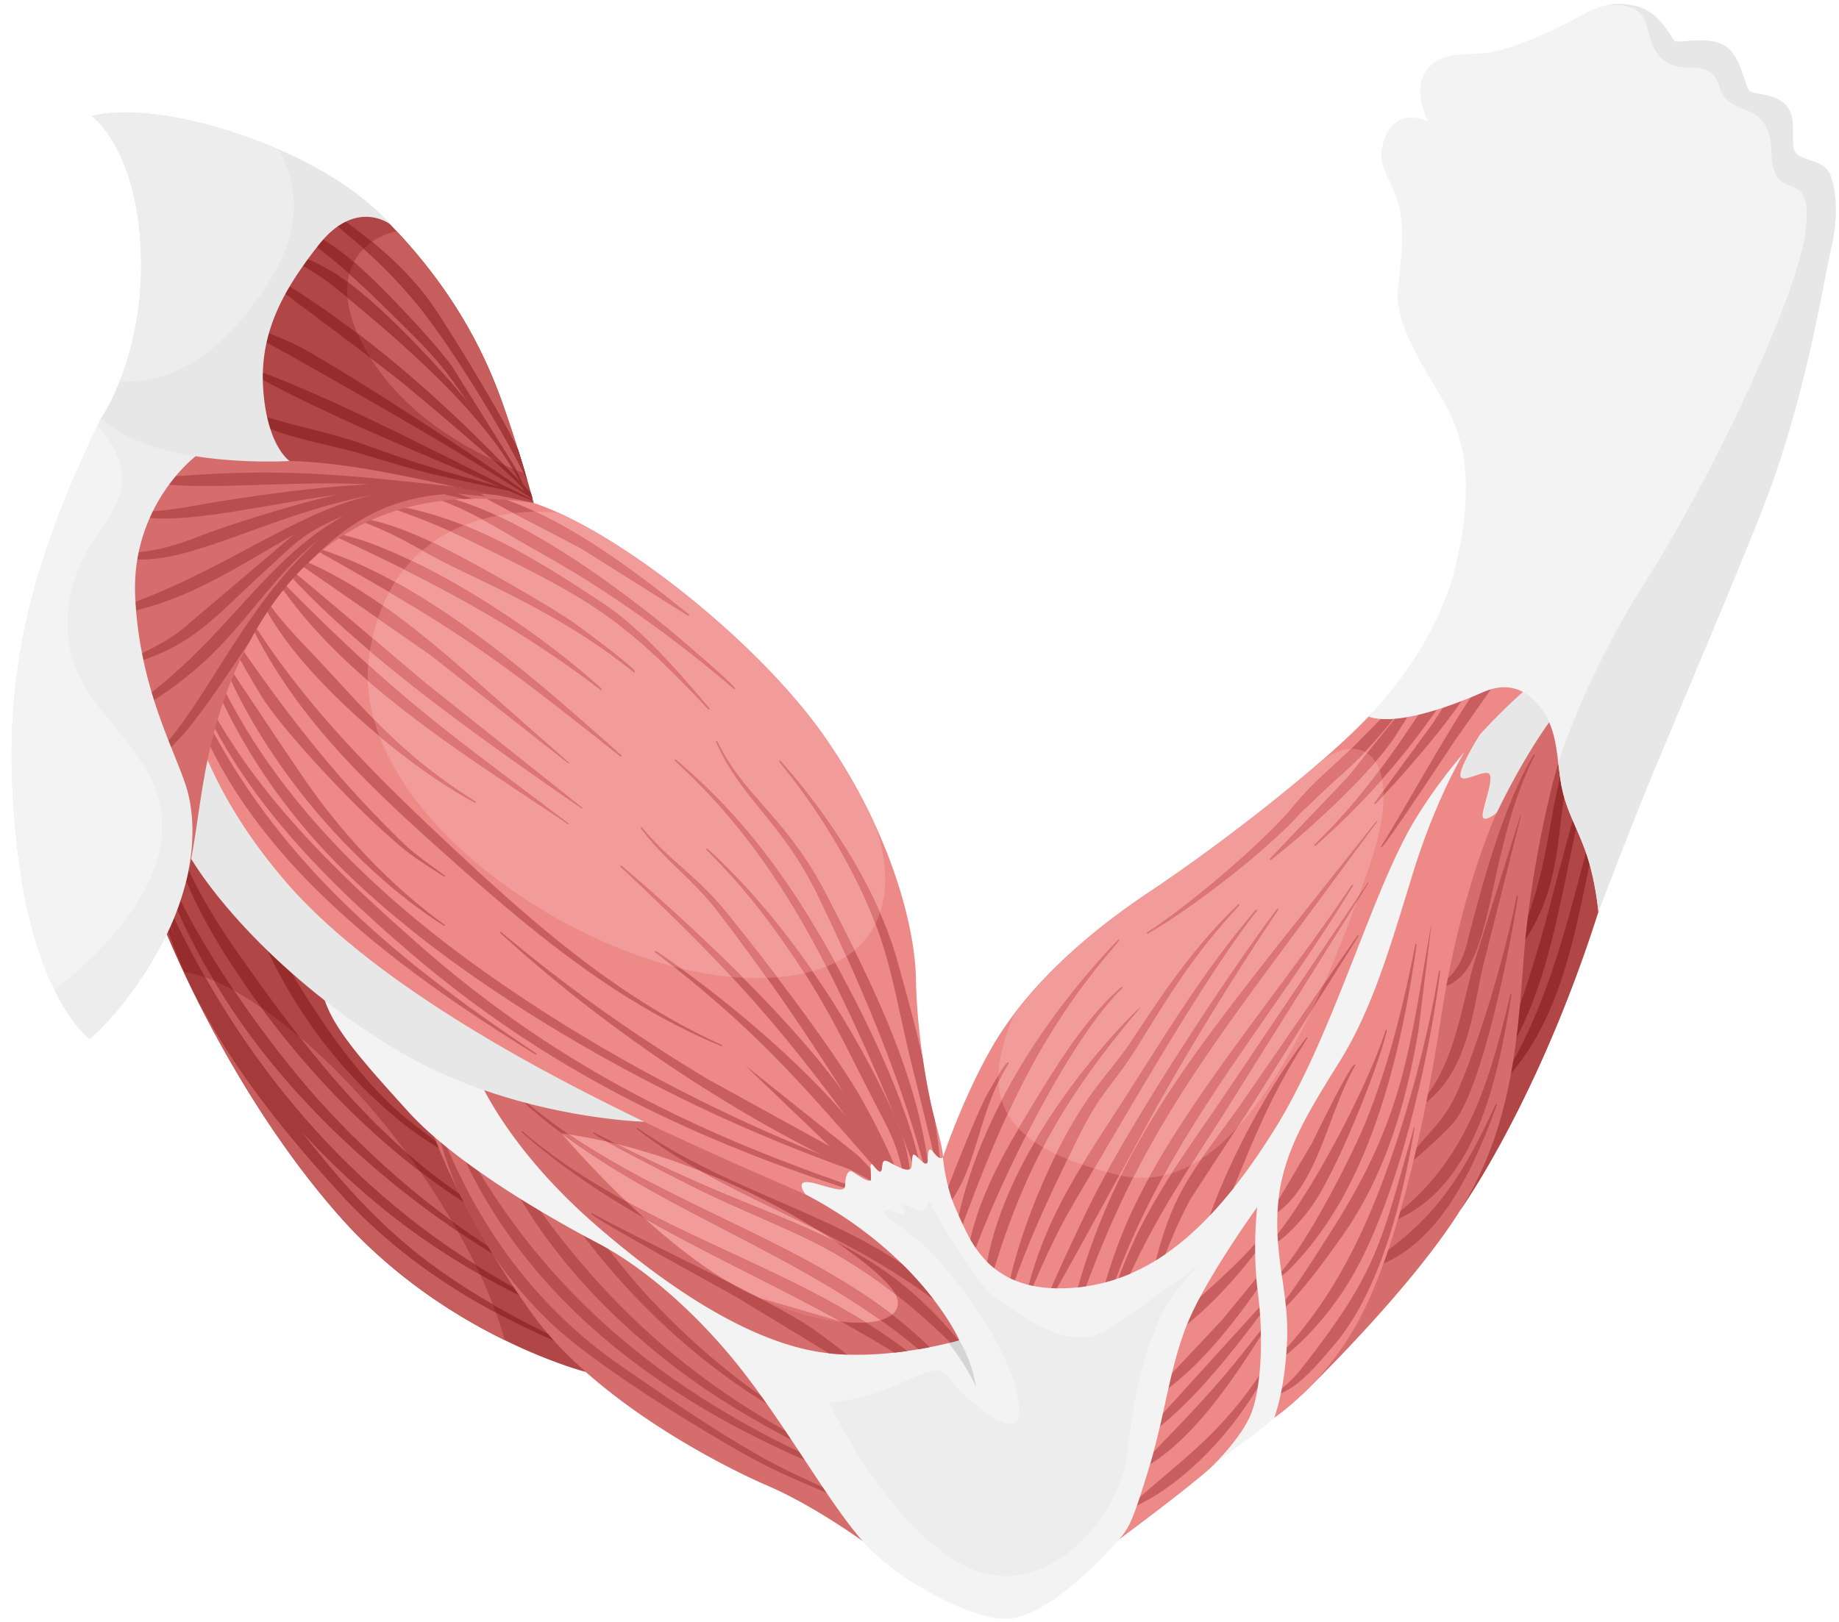
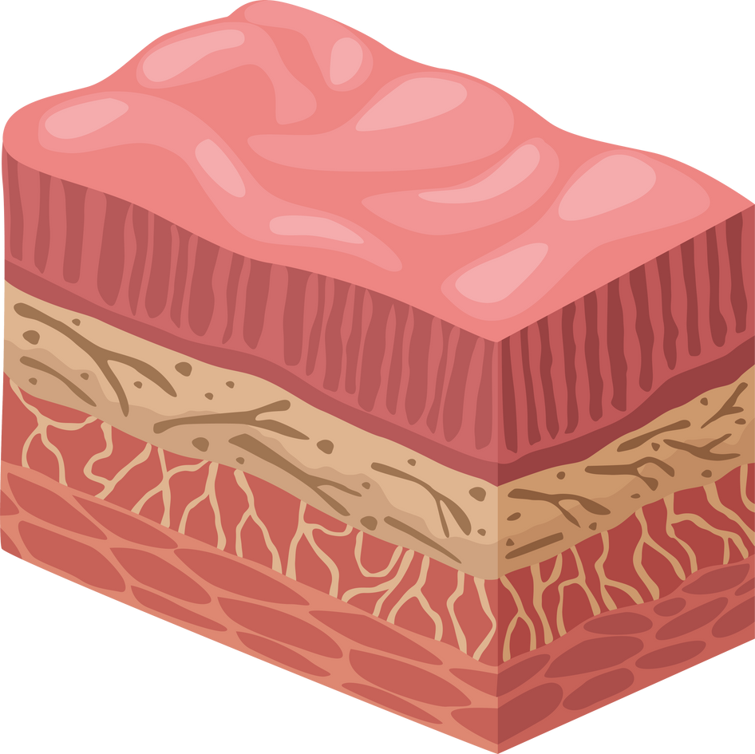
WHAT IS TISSUE?
Tissue is a group of cells that have the same structure and function.
Notes:
1. What Are Tissues?
Definition: Tissues are groups of similar cells that work together to perform a specific function. For example, muscle tissue is made of muscle cells that work together to enable movement.
Types of Tissues: There are four main types of tissues in the human body:
Epithelial Tissue: Covers surfaces and lines organs, such as skin and the lining of the digestive tract.
Connective Tissue: Provides structure and support, like bone and cartilage.
Muscle Tissue: Allows for movement, found in muscles like the heart and skeletal muscles.
Nervous Tissue: Transmits signals throughout the body, found in the brain and nerves.

Slide 9
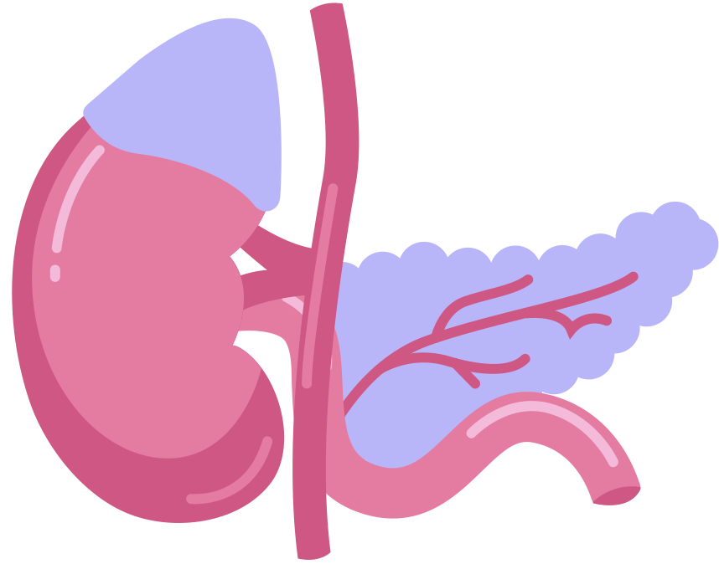
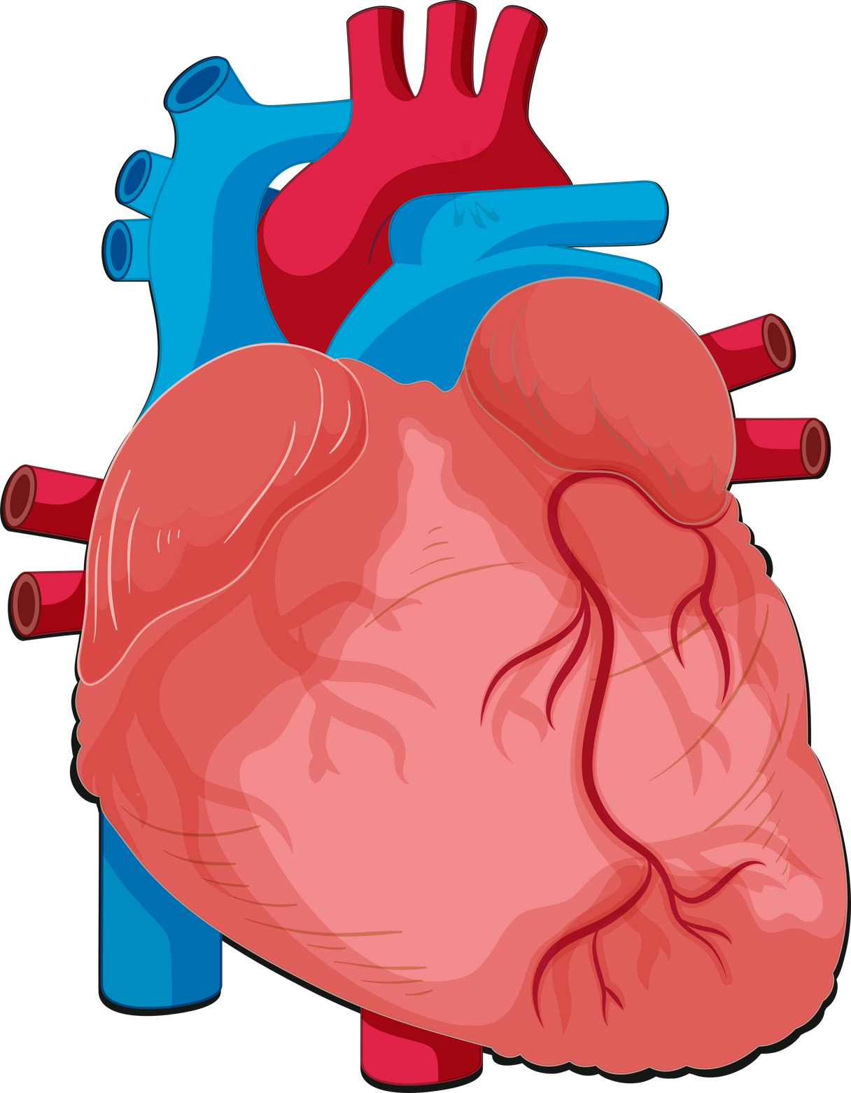
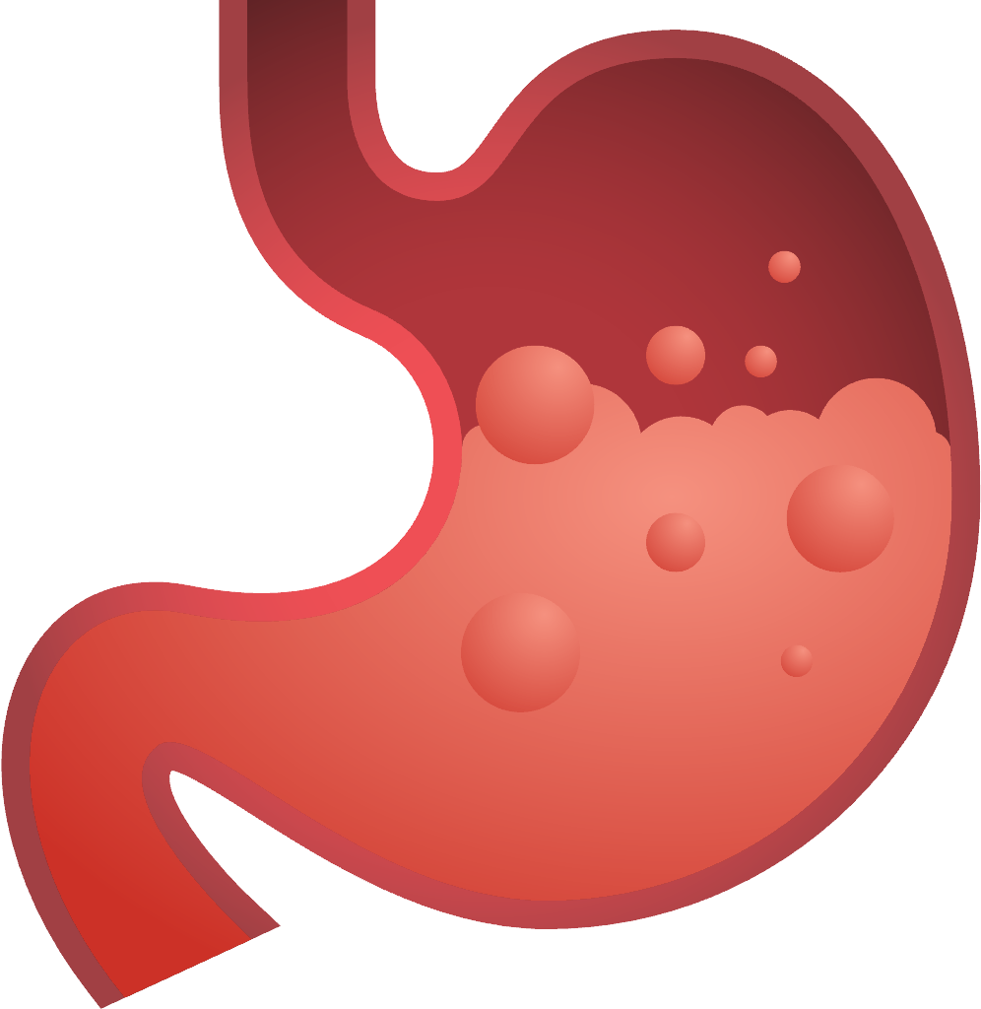
WHAT ARE ORGANS?
Organs are made up of two or more
types of tissue organised to perform a
specific function.
Notes:
How Tissues Form Organs
Definition of Organs: Organs are structures made up of multiple types of tissues that work together to perform complex, specific functions.
For example, the stomach is an organ involved in digestion, with muscle tissue to churn food, epithelial tissue to protect the lining, and connective tissue to support its structure.
Example of Tissues Working
Together in an Organ:
In the heart, muscle tissue enables pumping, connective tissue supports the structure, and nervous tissue helps regulate the heartbeat. These tissues collaborate to ensure the heart can pump blood effectively.

Slide 10
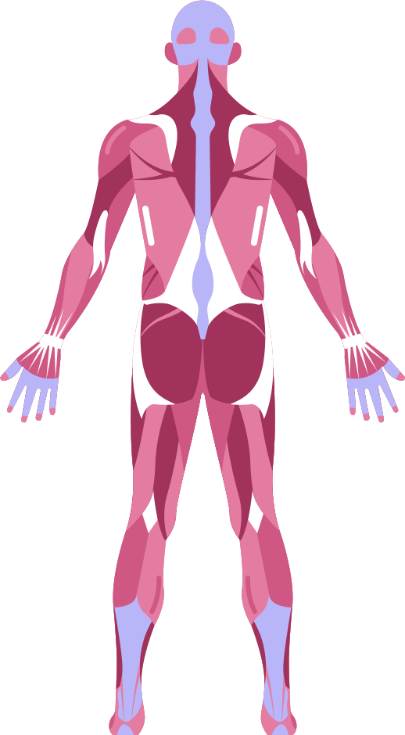
HOW ARE THEY RELATED?
Notes:
Connecting Tissues and Organs to Each Other
Organ Systems: Organs don’t work in isolation; they are connected to other organs to form organ systems, like the digestive or respiratory systems. For instance, the stomach, intestines, liver, and pancreas all work together as part of the digestive system to process food, absorb nutrients, and eliminate waste.
Communication Between Tissues and Organs: Tissues and organs communicate through nervous signals, hormones, and blood flow, allowing them to coordinate activities. For example, when you’re hungry, your brain signals your stomach to prepare for digestion.
Relevance to Non-Animal Models in Research
Understanding how cells form tissues and organs allows scientists to replicate these structures in lab settings, like organoids or organ-on-a-chip technologies. These models can mimic human organ function, enabling researchers to study disease or test drugs in systems that resemble actual human organs.

Slide 11
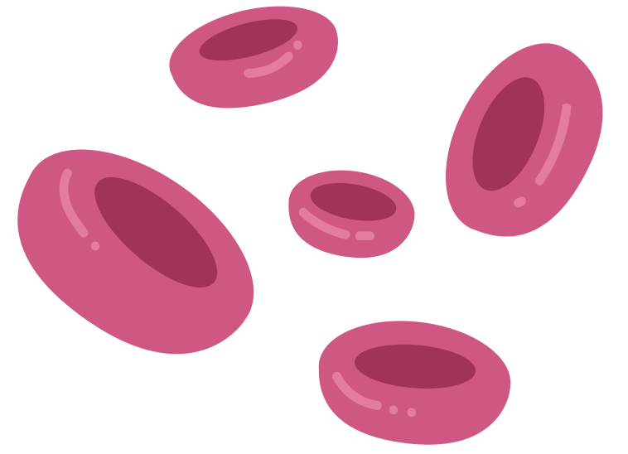

CELLS
TISSUES
ORGANS

Slide 12
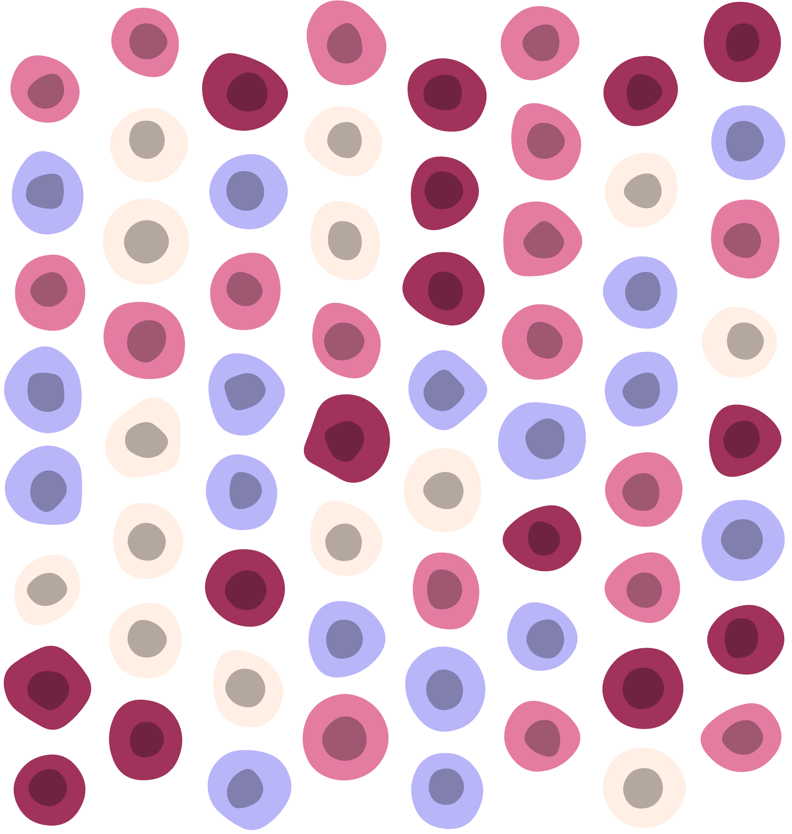
HOW DO THEY HELP US
SURVIVE?

Slide 13
TRANSFER NUTRIENTS AND WASTE AROUND THE BODY
CELLS
PROVIDE SHAPE, STRUCTURE AND PROTECTION
TISSUES
ALLOW BODY SYSTEMS TO PERFORM SPECIFIC FUNCTIONS
ORGANS
Notes:
1. Cells: The Building Blocks
What They Are: Cells are the smallest functional units of life, carrying out the basic processes that keep an organism alive, like energy production and waste removal.
Example: Muscle cells, nerve cells, and skin cells all have specialized functions that support different processes in the body.
2. How Cells Form Tissues
Definition of Tissues: When groups of similar cells with the same function come together, they form tissues. Each tissue type is designed to perform specific tasks that contribute to the body’s function.
3. How Tissues Form Organs
Definition of Organs: An organ is a complex structure made up of multiple types of tissues working together to perform a specific function.
Examples of Organs:
The heart is made up of muscle tissue for pumping, connective tissue for support, and nervous tissue for regulation. These tissues work together to circulate blood.
The stomach includes muscle tissue to churn food, epithelial tissue to line the stomach wall, and connective tissue to support the organ structure. Together, these tissues digest food and absorb nutrients.
Function of Organs: Each organ has a specialized role, contributing to larger organ systems like the respiratory, digestive, and circulatory systems.

Slide 14
ORGANOIDS

Slide 15
WHAT ARE ORGANOIDS?
Organoids are scientific advancements that recreate organs but in mini form and in highly controlled laboratory settings.

Slide 16

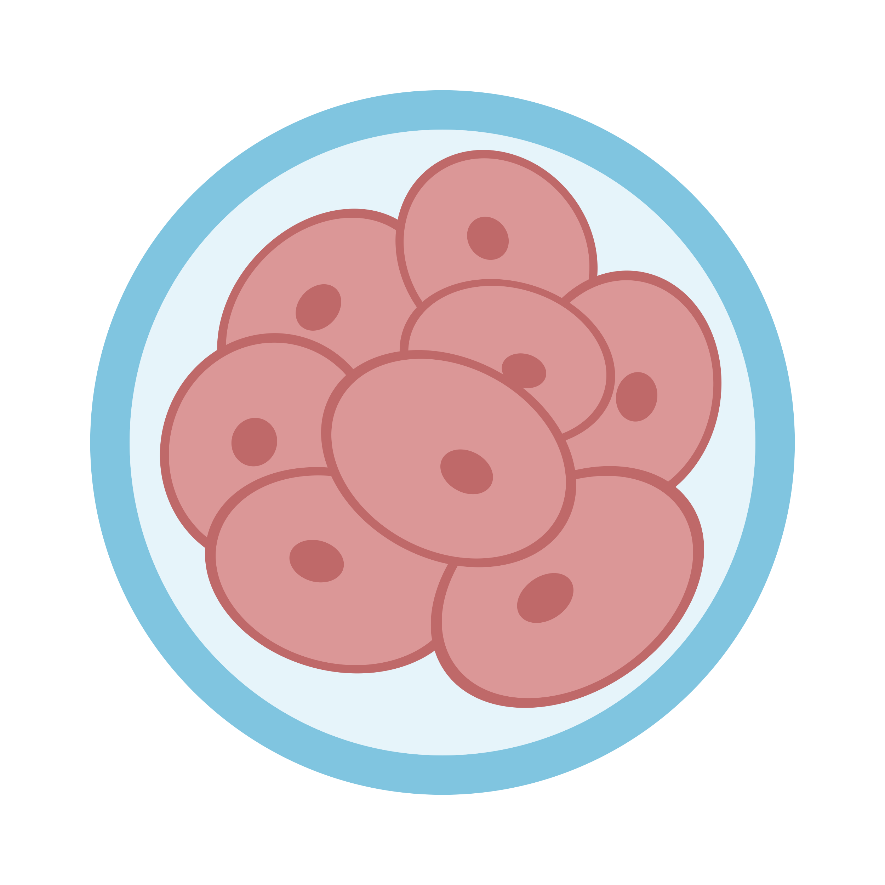
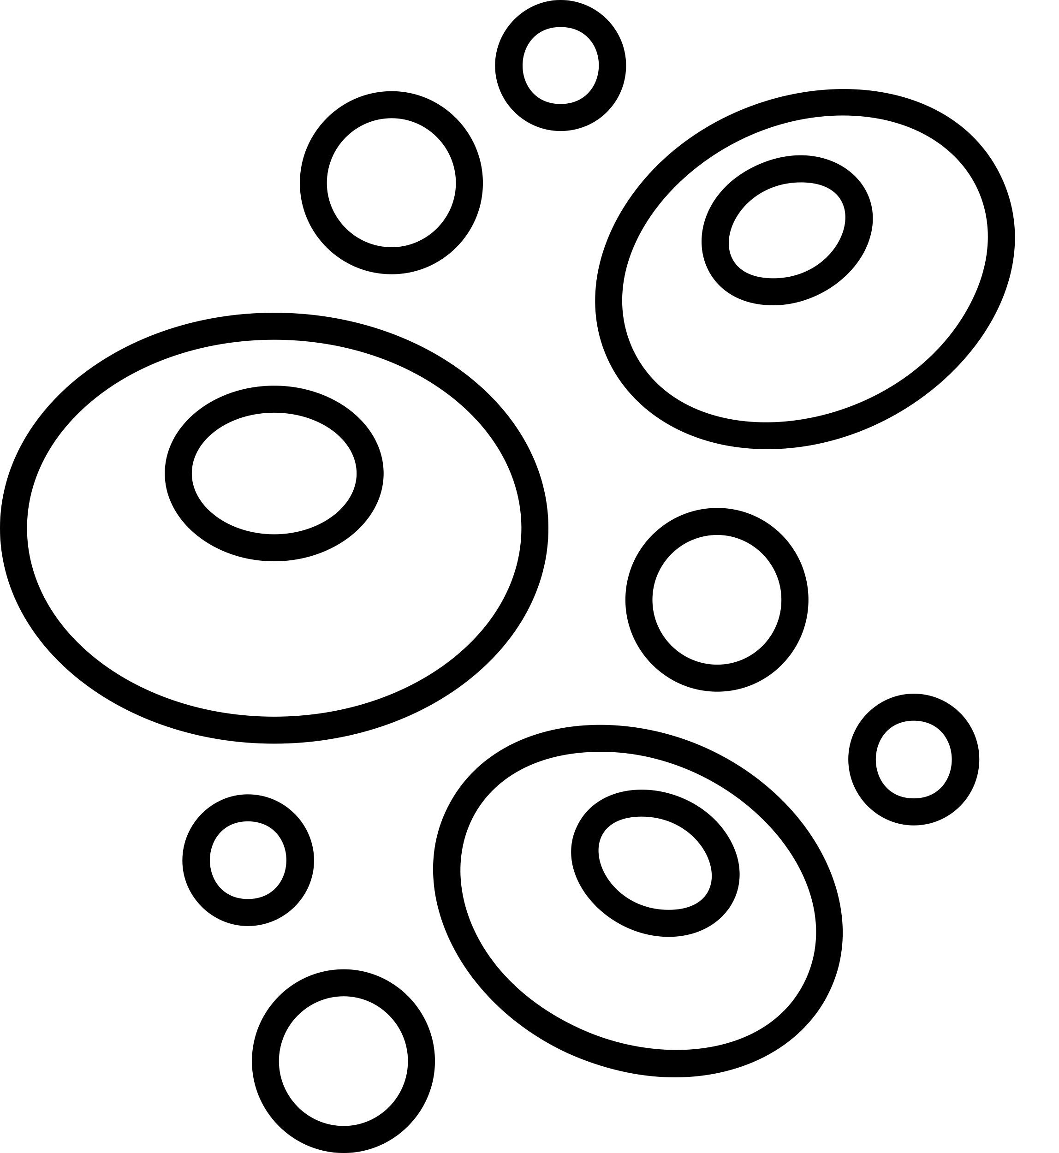

Organoids are clusters of cells grown from donated cells or stem cells that self-organize into structures resembling mini-organs. These organoids can replicate the structure and function of real human organs, including the interactions between cells and tissues.
Drug Discovery
Toxicology
Precision Medicine
Stem Cells
Organoid
Notes:
What are organoids?
Organoids are 3D clusters of cells grown from stem cells that self-organize into structures resembling miniature organs. These organoids can replicate the architecture and function of real human organs, including the interactions between cells and tissues.
Why this is important:
In the lab, scientists use organoids to model specific human organs, such as the brain, liver, or lungs. This allows researchers to study how diseases affect organs or how drugs interact with specific tissues, providing a more accurate understanding of human biology than animal models.
Stem cells are unspecialized cells that can develop into many different types of cells in the body. They are the body's repair system, replacing injured or lost cells and tissues throughout life.
Stem cells are important because they:
Act as templates: Stem cells act as templates with instructions for creating new cells.
Can be used in medical research: Stem cells can help explain the causes of serious conditions like cancer and birth defects.
Can be used in medical therapies: Stem cells may be used to create cells and tissues for treating diseases like Parkinson's disease, Alzheimer's disease, and spinal cord injury.
Can be used to test drugs: Stem cells can be used to test new drugs for safety and effectiveness.
Connecting to tissues and organs:
Just like tissues in the human body, organoids are made up of specialized cells that come together to mimic real organ structures. For example, a liver organoid contains liver cells that function similarly to how they would in the actual human liver, allowing scientists to test drug metabolism directly in human-like tissue.

Slide 17
Applications : Disease Modelling
Precision Oncology: Drug Resistance: By growing organoids from a patient’s cancer cells, researchers can identify which drugs the cancer is resistant to.
Infectious Diseases: Organoids are used to model infections by pathogens such as SARS-CoV-2 (COVID-19 allowing scientists to observe how diseases interact with human tissues.
Neurodegenerative Disorders: Brain organoids are used to study Alzheimer’s, Parkinson’s, and autism by mimicking the nerve cell networks of the human brain.
Precision Medicine
Scientists can create an organoid using cells of a person suffering from a particular disease. They can then test different drugs to check which drug would be most effective in that person’s organoid before testing it on the actual person, ensuring better outcomes and fewer side effects.
Notes:
The biological, metabolic, and genetic differences between animals and humans make animal models unreliable for detecting mitochondrial toxicity, which is why human-relevant models, such as cell cultures or organoids, are better suited for studying these effects. These models allow researchers to observe how drugs affect human mitochondria directly, providing more accurate data.

Slide 18
ORGAN-ON-A-CHIP

Slide 19
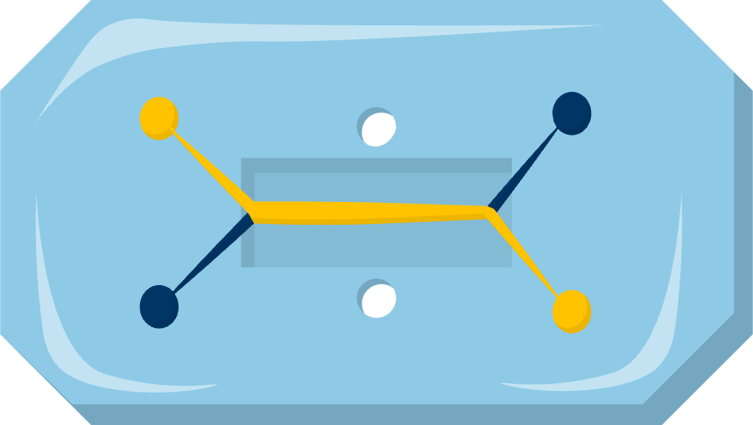
WHAT IS ORGAN-ON-A-CHIP?
Organ-on-a-chip technology is a scientific advancement that recreates organ structure and function but in miniaturized, highly controlled laboratory settings.

Slide 20
Organ-on-a-chip technology takes this one step further. It’s a tiny chip with channels like blood cells and is lined with living human cells that simulates the environment of organs. These chips recreate the way cells are organized in tissues and organs but also the mechanical processes that occur in the body, such as blood flow or nutrient exchange.
Drug Metabolism
Toxicology
Disease modelling
Stem Cells
Organ-on-a-Chip
Notes:
What is organ-on-a-chip technology?
Organ-on-a-chip technology takes this one step further. It’s a microfluidic device lined with living human cells that simulates the environment of entire organs. These chips recreate not only the cellular organization but also the mechanical and biochemical processes that occur in the body, such as blood flow or nutrient exchange.
Why this is important:
Unlike simple cell cultures or even animal models, organ-on-a-chip devices provide a dynamic environment where scientists can observe how cells behave under real physiological conditions. This is crucial for studying how diseases progress, how drugs are absorbed, or how toxins impact organs, in a way that reflects true human biology.
Connecting to tissues and organs:
While organoids recreate the structure of organs in 3D form, organ-on-a-chip technology goes a step further by mimicking the functionality of organs, allowing cells and tissues to interact in a way that mimics how organs work in the human body. For example, a lung-on-a-chip can replicate the mechanical motion of breathing, while a liver-on-a-chip can simulate drug metabolism in the liver.

Slide 21
Applications
Organs-on-chips replicate human organs, making them ideal for studying diseases in a controlled environment.
Cancer Research: Tumor-on-a-chip models mimic the tumour environment to study cancer progression and therapy responses.
Neurodegenerative Disorders: Brain-on-a-chip platforms are used to study conditions like Alzheimer’s and Parkinson’s disease.
Infectious Diseases: Lung and gut chips are used to study infections like COVID-19 or gastrointestinal infections.
Notes:
The biological, metabolic, and genetic differences between animals and humans make animal models unreliable for detecting mitochondrial toxicity, which is why human-relevant models, such as cell cultures or organoids, are better suited for studying these effects. These models allow researchers to observe how drugs affect human mitochondria directly, providing more accurate data.

Slide 22
Lab‑grown skin (human skin cell models)
Key idea: Layers of human skin cells grown in the lab mimic real skin structure & barrier.
Shows:
irritation/sensitivity
corrosion
barrier/permeation (does it get through?)
Great for: creams, cosmetics, soaps, adhesives, contact materials.
One limit: Local skin effects only — not whole‑body changes.
This helps because… it tells us quickly if a product irritates human skin.
Would you start a new skin cream test here? What question does this answer first?
Notes:
Teacher script (20–30s): These are living layers of human skin cells. They let us check irritation and whether something passes the skin barrier. Because it’s human skin, results are human‑relevant. If we needed whole‑body effects, we’d add other human‑first steps later (e.g., modelling).

Slide 23
Liver Organoids (mini-livers)
Key idea: Tiny 3D ‘mini‑livers’ grown from human cells that perform key liver functions.
Shows:
metabolism (how the liver breaks it down)
early liver toxicity
enzyme signals
Great for: medicines processed by the liver, chemical exposure comparisons.
One limit: Mini‑liver, not a whole body (doesn’t show kidneys/gut/hormones).
This helps because… it gives early warnings if something hurts human liver cells.
If organoids show stress, what would your next human‑first step be?
Notes:
Teacher script (20–30s): These are living layers of human skin cells. They let us check irritation and whether something passes the skin barrier. Because it’s human skin, results are human‑relevant. If we needed whole‑body effects, we’d add other human‑first steps later (e.g., modelling).

Slide 24
Heart-on-a-chip (heart cells)
Key idea: A tiny device with beating human heart cells and flowing nutrients; sensors track the beat.
Shows:
beat rate
rhythm (too fast/slow/uneven?)
Contractions and relaxation
dose‑response
Great for: energy drinks, cough/cold meds, and cardio‑active medicines.
One limit: It’s a piece of the heart — pair with other human data for the bigger picture.
This helps because… it reveals if a substance changes the human heartbeat.
Where would you place heart‑on‑a‑chip in a test plan — first, second, or later? Why?
Notes:
Teacher script (20–30s): These are living layers of human skin cells. They let us check irritation and whether something passes the skin barrier. Because it’s human skin, results are human‑relevant. If we needed whole‑body effects, we’d add other human‑first steps later (e.g., modelling).

Slide 25
How these methods answer real questions
Irritation? → Start with Lab‑grown skin; add a quick permeation check; model absorption if needed.
Liver safety? → Start with Liver organoids; add PBPK/in‑silico modelling; consider kidney/gut models next.
Heartbeat? → Start with Heart‑on‑a‑chip; confirm across doses; add modelling
Task (2‑min): Pick one scenario and choose a 2‑step human‑first pipeline. Finish the sentence:
“We’d start with __ then ___ because ___.”
Notes:
Teacher script (20–30s): These are living layers of human skin cells. They let us check irritation and whether something passes the skin barrier. Because it’s human skin, results are human‑relevant. If we needed whole‑body effects, we’d add other human‑first steps later (e.g., modelling). (KS5: consider Phase 0 human microdosing).

Slide 26
Applications :
Multi-Organ Interaction Studies
Organs-on-chips can be linked to study complex interactions between different organs.
Body-on-a-Chip: Integrated systems simulate multiple organ interactions, such as liver metabolism affecting heart toxicity.
Good for: Multi-organ chips are used to study diseases that involve multiple organ systems, like diabetes.
Notes:
The biological, metabolic, and genetic differences between animals and humans make animal models unreliable for detecting mitochondrial toxicity, which is why human-relevant models, such as cell cultures or organoids, are better suited for studying these effects. These models allow researchers to observe how drugs affect human mitochondria directly, providing more accurate data.

Slide 27
REPLICATING HUMAN CELL BIOLOGY IN NON-ANIMAL HUMAN-RELEVANT MODELS
HUMAN-RELEVANT MODELS PROTECT HUMANS FROM UNSAFE TOXINS BY PROVIDING ACCURATE RESULTS.
ANIMAL SUFFERING IS COMPLETELY PREVENTABLE WITH MODERN SCIENCE
THESE METHODS ELIMINATE OUTDATED AND INEFFECTIVE ANIMAL TESTING.
Notes:
Replicating Human Cell Biology in Non-Animal Human-Relevant Models is The Key to Effective, Modern Science

Slide 28
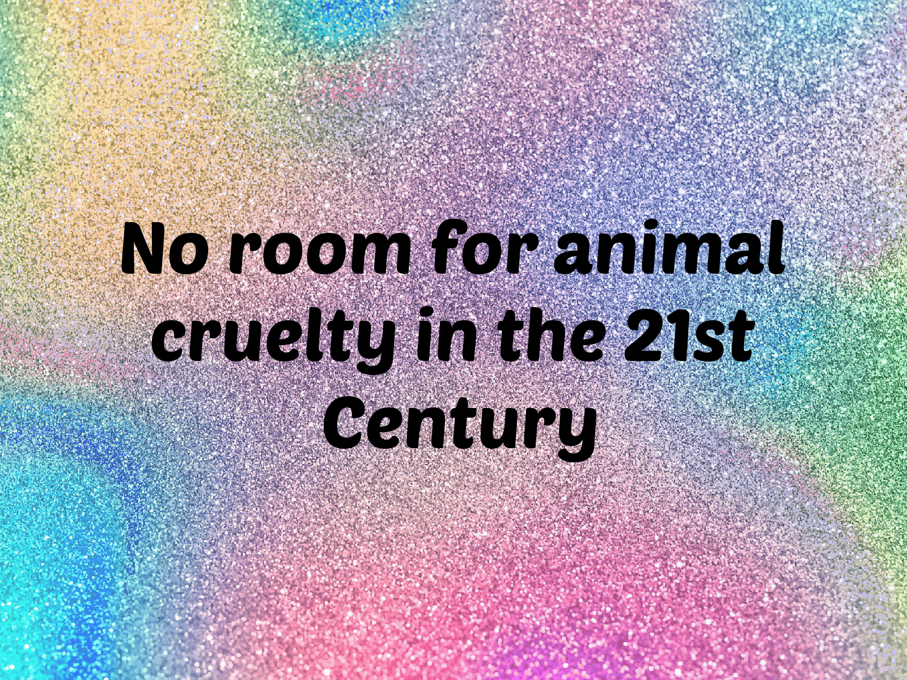

THE FUTURE OF SCIENCE IS ALREADY HERE
The time for change is now

